Slide 1

Slide 1

Slide 2
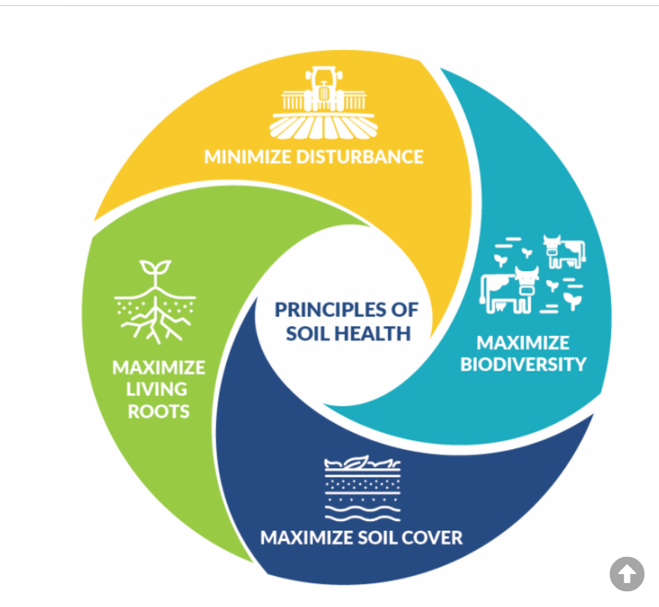
Soil Health
Soil is not an inert growing medium – it is a living and life-giving natural resource. It is teaming with billions of bacteria, fungi, and other microbes that are the foundation of an elegant symbiotic ecosystem.
Natural Resources Conservation Service
U.S. Department of Agriculture
Principles to Manage Soil for Health
Soil health research has determined how to manage soil in a way that improves soil function.
Maximize Presence of Living Roots
Minimize Disturbance
Maximize Soil Cover
Maximize Biodiversity
Source: https://www.nrcs.usda.gov/conservation-basics/natural-resource-concerns/soils/soil-health

Slide 3
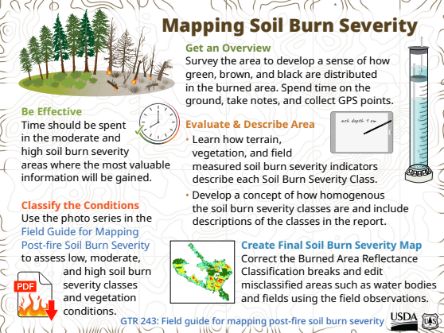
Description: Provides guidance on assessing soil burn severity after wildfires, crucial for land restoration efforts.
Organization: USDA Forest Service
https://research.fs.usda.gov/sites/default/files/2023-10/rmrs-soil-map-infographic-english.pdf

Slide 4
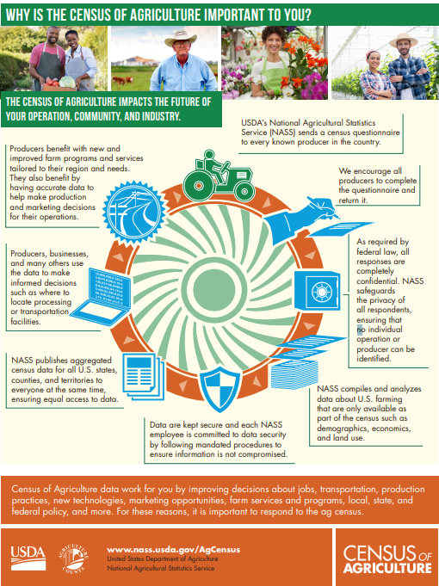
Importance of the Census of Agriculture
Organization: USDA National Agricultural Statistics Service (NASS)
Description: Presents data on land use, crop production, and conservation practices across the U.S.
https://www.nass.usda.gov/AgCensus/Partners/2022/Infographics/Infographic_ImportanceAgCensus2022.pdf

Slide 5
Snapshot of Australian Agriculture 2025
This Insights report describes the current state of Australian agriculture, with the aim of providing key information and statistics in one place. It covers eight key aspects of Australian agriculture: its role in the broader economy, trends in production, farm incomes, industry structure and productivity, climate change impacts and risk management, agricultural employment, sustainability and trade.
https://www.agriculture.gov.au/abares/products/insights/snapshot-of-australian-agriculture#emissions-reduction-pathways

Slide 6
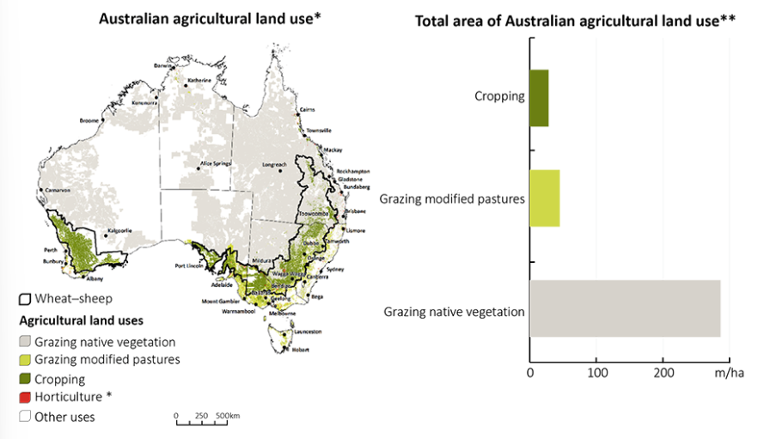
Figure 1 Australian agricultural production zones
Note: *Exaggerated to improve visibility
** Horticulture not represented as it is less than 1 million hectares of agricultural land use
Source: Wheat-sheep zone – Australian Agricultural and Grazing Industries Survey, 2016, ABARES; Catchment scale land use of Australia – update December 2023, ABARES; ABS Agricultural Commodities, Australia, 2020–21 (cat 7121)

Slide 7
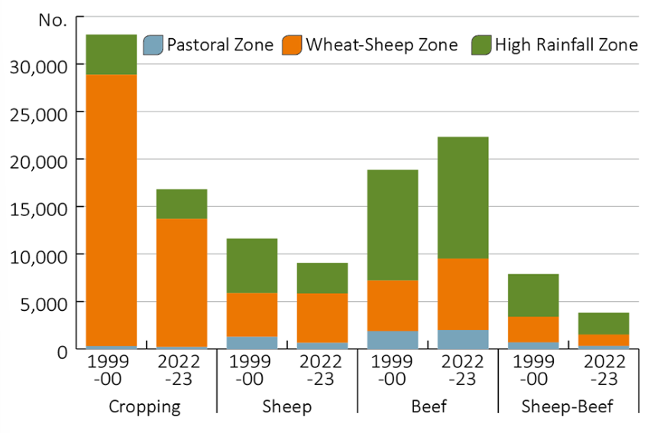
Figure 2 Number of broadacre farms by zone, Australia, 1999–00 and 2022–23
Source: ABARES Australian Agricultural and Grazing Industries Survey

Slide 8
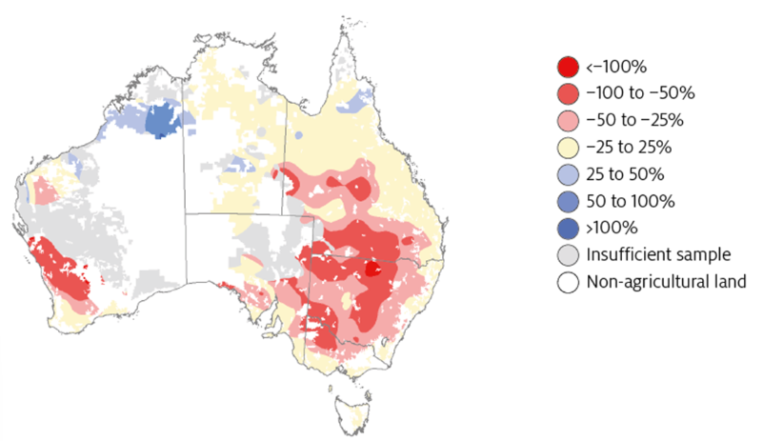
Figure 3 Changes in seasonal conditions over the past 20 years have reduced average annual broadacre farm profitability
Note: Change in average annual farm profitability 2001-2020 relative to 1950-2000. Annual farm profitability is simulated by applying historical climate conditions to fixed farm characteristics observed between 2015-2019. This analysis isolates the impact of changes in climates conditions on farm profitability; other exogenous inputs including commodity prices and farm inputs are held constant. For more information, see Hughes et. al 2022a.
Source: Hughes, N, Lu, M, Soh, W Y, & Lawson K 2022a, Modelling the effects of climate change on the profitability of Australian farms, Climatic Change, vol. 172

Slide 9
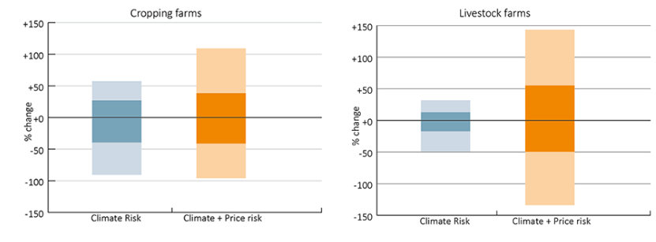
Figure 4 Change in annual broadacre farm profitability due to climate and price risks
Note: Farm profitability is simulated by applying historical climate conditions and commodity prices over the past 33 years (2022-23 to 1990-91) to the 2021-22 farm cohort, holding farm characteristics constant. Profit outcomes for the past 33 years are ordered by percentile (solid bars represent 25th-75th percentiles, shaded bars represent 5th-95th percentiles).
^Change in profit is presented relative to the median year.
*Change in profitability given historical climate conditions, commodity prices held constant (isolated impact of climate on profitability). For more information see Hughes et al.
Source: ABARES farmpredict

Slide 10
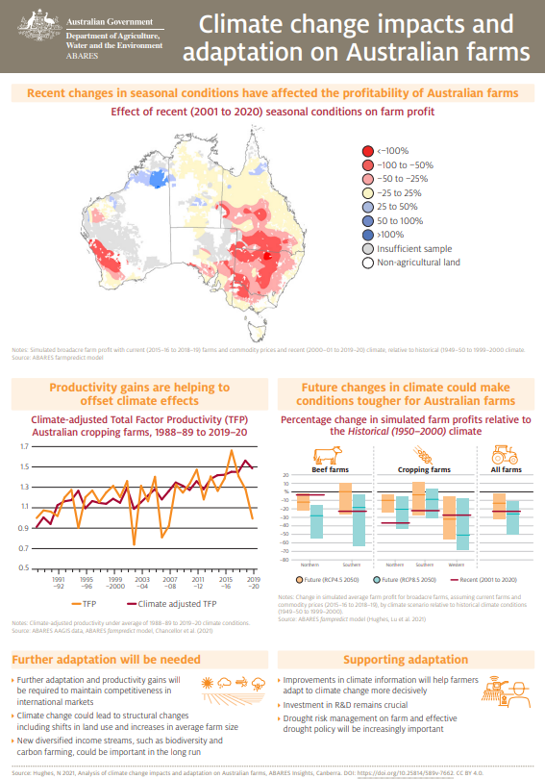
https://daff.ent.sirsidynix.net.au/client/en_AU/search/asset/1032401/1

Slide 11
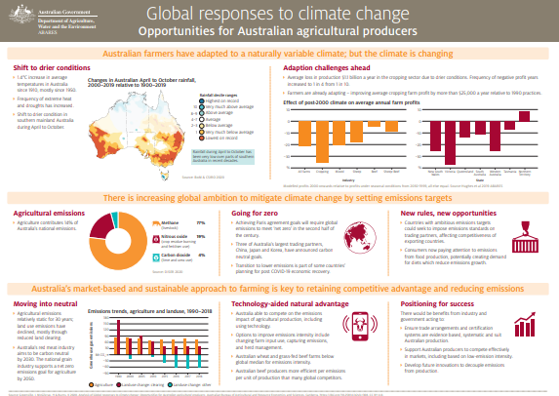
https://daff.ent.sirsidynix.net.au/client/en_AU/search/asset/1031063/1

Slide 12
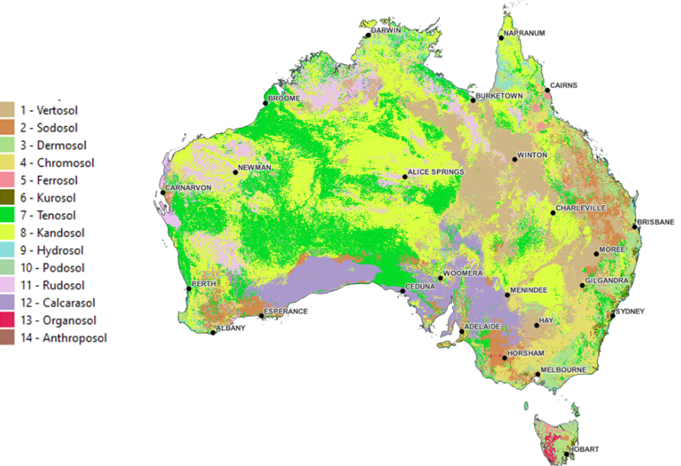
New digital soil map of Australia’s soil orders made possible using the SoilDataFederator
Sources: Searle (2021a), Searle (2021b); map projection: Australian Albers GDA94 (ICSM n.d.)

Slide 13
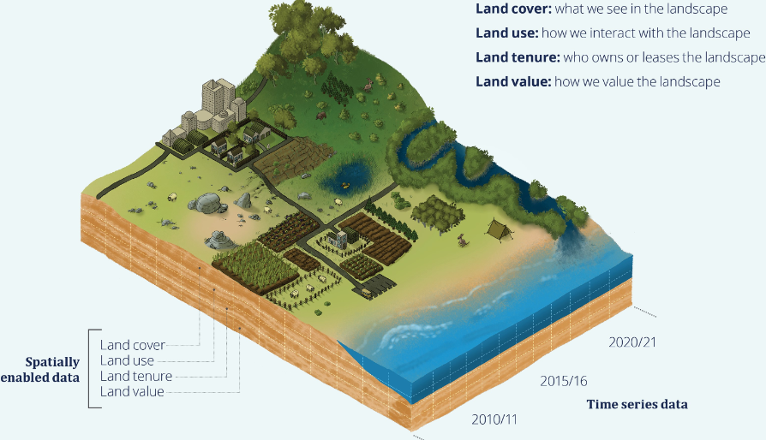
The 4 themes of the land accounts

Slide 14
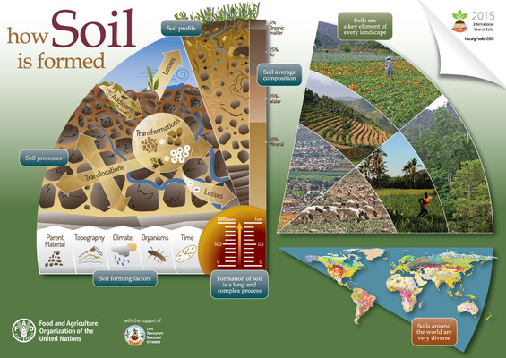
Global Soil Partnership Infographics
Series of posters dedicated to soil processes, functions, and threats, with relevance to South American contexts.

Slide 15
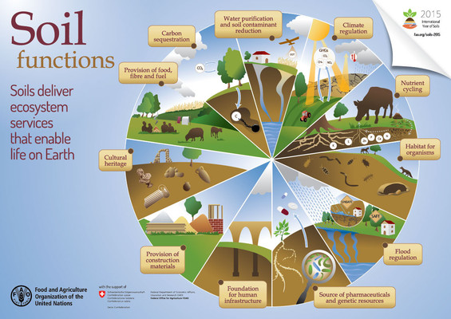
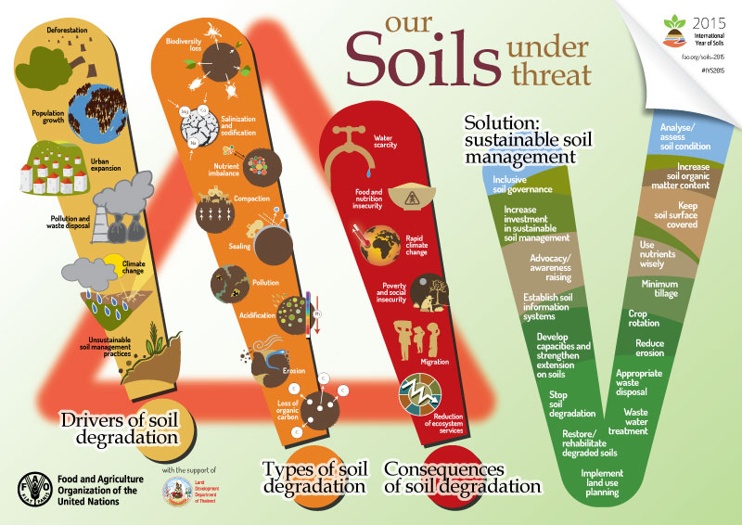
South America
https://www.fao.org/global-soil-partnership/resources/news/presentations-gsb23/en/c/284443/

Slide 16
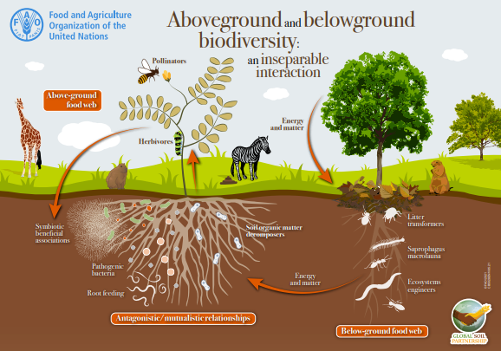
https://openknowledge.fao.org/server/api/core/bitstreams/a5657370-98de-4c50-a6e2-96def5df78d4/content

Slide 17
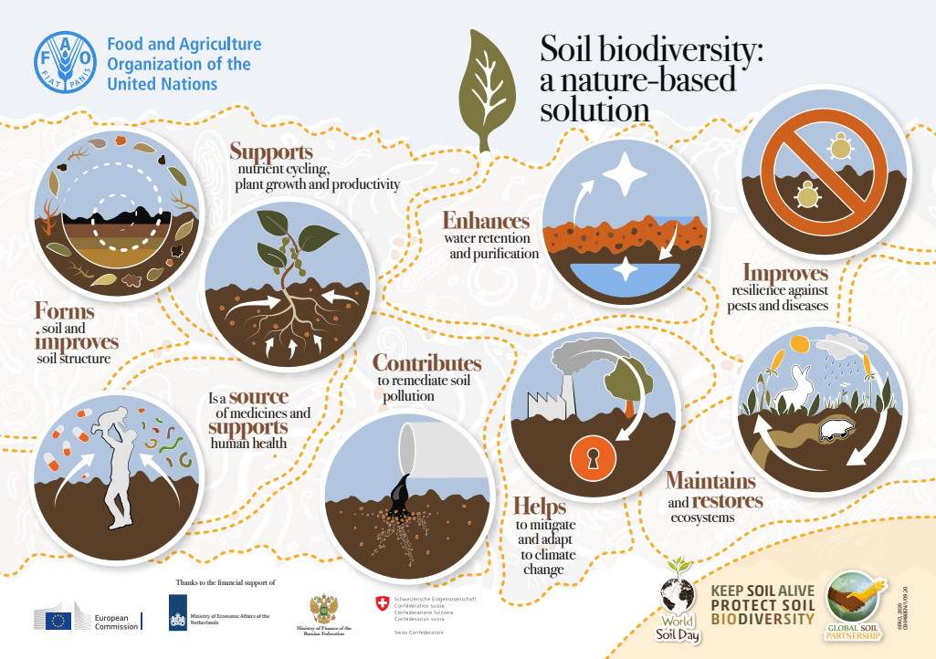
https://openknowledge.fao.org/server/api/core/bitstreams/33b83181-d743-432d-a0b2-89b007f1a27b/content

